Slide 1


Melanoma Classification
Mind The Skin
Ioanna Ioannou
Nikolaos Panagiotopoulos
Andriani Karpathaki

Slide 2
Contents
BUSINESS
CASE
01
DATA PREPROCESSING
03
BUILDING THE MODELS
04
CONCLUSIONS
05
Data
overview
02

Slide 3

Business Case

Slide 4
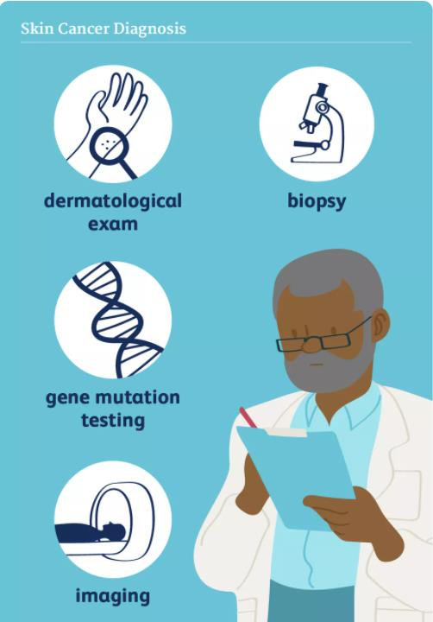

Business Case
Use of ML to classify Melanoma using Skin Lesion Images
Skin Diagnosis procedure includes painful and time-consuming process
I am a quick learner!
Business Questions
Can we have a reliable early-stage diagnosis in order to treat the patient early?
Can we use it in order to avoid long and painful procedures that are used currently?
Machine Learning

Slide 5

Data Overview

Slide 6
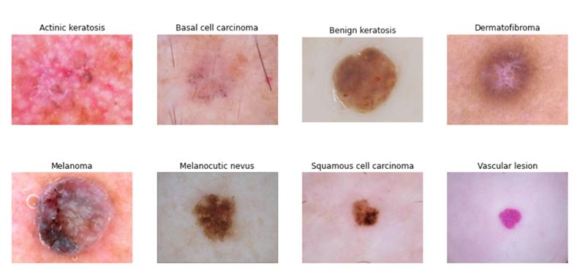
Data Overview
25.331 images
The data used was collected from Kaggle and has been originated from the Department of Dermatology, Hospital Clinic de Barcelona and the Department of Dermatology, Medical University of Vienna.
8
categories
The dataset consists of 25.331 images belonging to 8 different diagnostic categories.

Slide 7
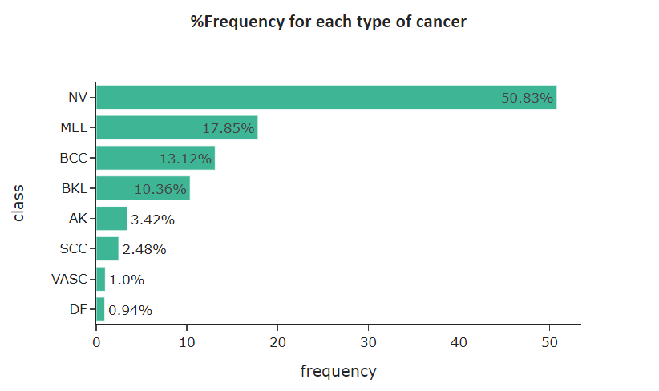
Data Overview
The bar plot shows the percentage distribution of disease type in our dataset.
Frequency distribution of disease type
Most units in the sample (almost 90%) come from four types of skin cancer,
One type of class represents more than half of the total population.

Slide 8

Data Preprocessing

Slide 9
Data Preprocessing
One necessary step for performing Machine Learning analysis is Data Preprocess so as:
import and prepare the dataset using python programming language
data to take a form that can be easily used to create a model
avoid certain errors such as overfit
Split the dataset into a train, a validation and test dataset
Overfit occurs when the model or the algorithm fits the data too well, but it negatively impacts the performance of the model on new data.
High variance
Splitting data
Not enough data to train
Data augmentation techniques
Normalize and rescale the images

Slide 10
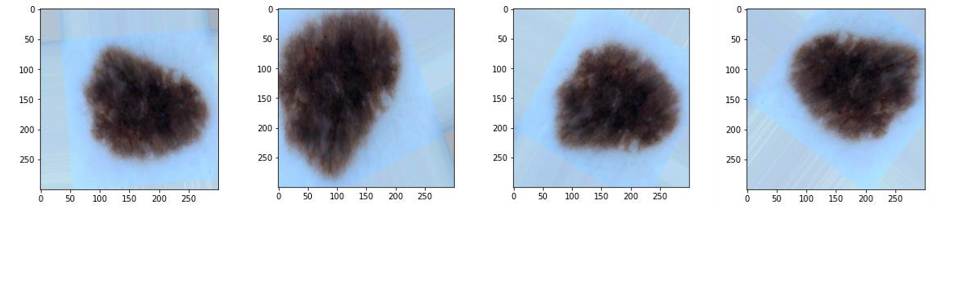
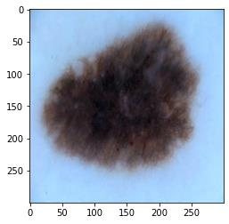
Data Preprocessing
Data augmentation includes a wide range of techniques used to generate “new” training samples.
ensuring the class labels of the data are not changed
saving a lot of memory
Data Augmentation
A substantial way to expand the size of our dataset in order to improve the performance and ability of the model to generalize, was the implementation of data augmentation technique.
Original Image

Slide 11
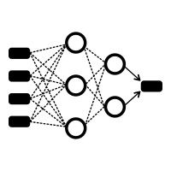
Building the models

Slide 12
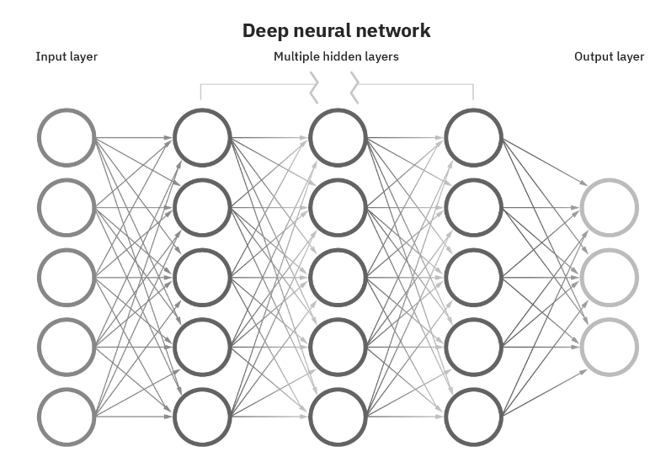
Building the Models
Arificial Neural Networks (ANNs)
Neural networks and deep learning techniques are often used for solving image recognition problems.
Their structure remarkably resembles the human brain and the way biological neurons signal to one another
Data Augmentation Results

Slide 13
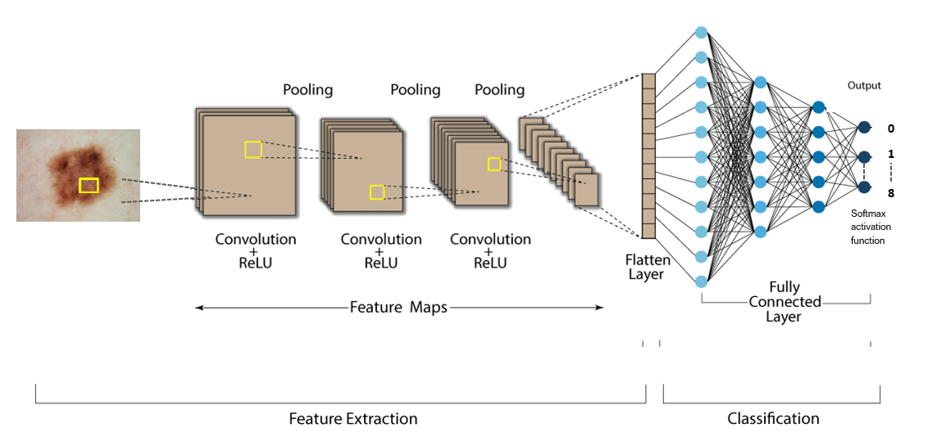
Building the Models
Convolution
Invariant feature detection
Reduces Overfitting
Convolutional neural network (CNN)
Convolutional neural networks (CNN), one of the main parts of neural networks architecture, primarily use image recognition in order to detect objects, in our case of study, skin lesion objects, and then classifies images based on the results.
ReLu
function
Forwards important information
Speeds up training process
Max Pooling
Reduces the dimensions of the final product
7
Classification
Via SoftMax Activation function the image is classified
Data Augmentation Results

Slide 14
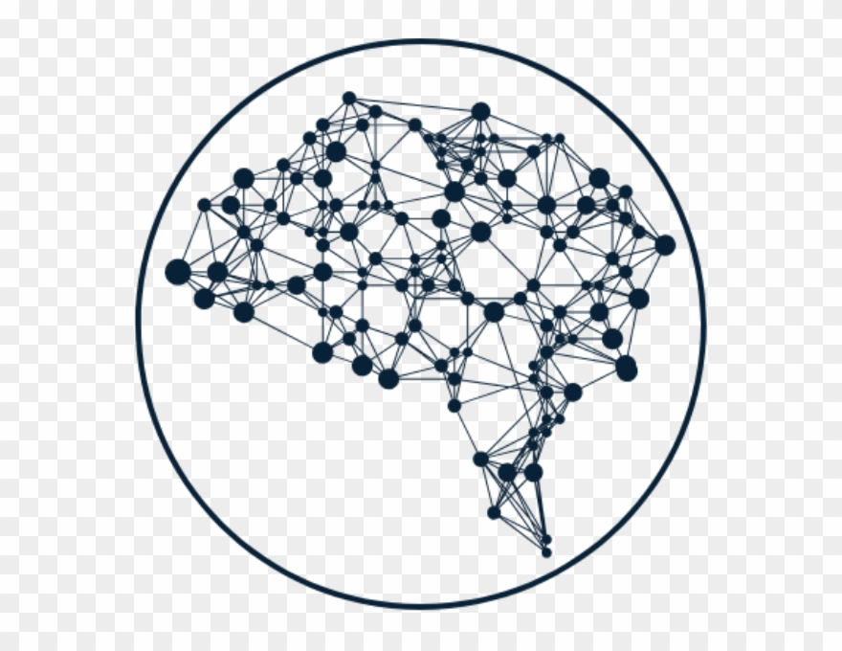
Building the Models
Convolutional neural network (CNN)
In this report we have built three differentiated Convolutional neural network (CNN) models.
one convolutional neural network (CNN)
one CNN model after conducting data augmentation techniques
one pretrained VGG16 model, one of the most used image-recognition architectures.
1
2
3
Data Augmentation Results

Slide 15
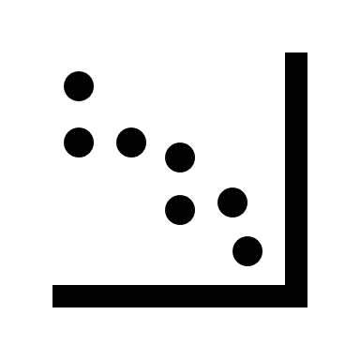
Building the Models
1. Model - Convolutional neural network (CNN)
Building the model
Compiling the model
A 2-dimensional convolutional layer with 32 neurons with kernel size of 3X3 and with ReLu activation
A 2-dimensional convolutional layer with 64 neurons with kernel size of 3X3, with ReLu activation
a Max Pooling layer with 2*2 filters and stride 2 to cut the size of the convolutional layers
A dropout to regularize the model and avoid the issue of overfitting
Then we flatten the MaxPooling Layer
Another Dense layer of 128 neurons with Relu activation
A Softmax Activation to make the probabilities
Optimizer: Optimizes the accuracy of a model by controlling the learning rate. In this project we used ‘adam’ as an optimizer as it is widely used and needs little memory.
Loss Function: measures the distance that is between the current output of the algorithm and the expected output. We used ‘categorical_crossentropy’ for our loss function which is the most common choice for classification.
Accuracy: statistical measure which shows the proportion of correct predictions of a model, thus the closer the accuracy is to value one the better the model is.
Data Augmentation Results
Now we are ready to fit the training and validation dataset into the model

Slide 16
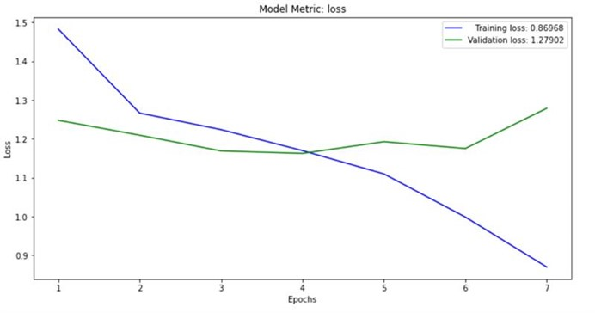
Building the Models
Loss function decreases rapidly for training, indicating that the network is learning fast.
In terms of validation, though, the loss curve flattens and then suddenly starts to increase.
This is commonly a result of overfitting.
1. Model - Convolutional neural network
Model metric: Loss Function
Loss function measures the distance that is between the current output of the algorithm and the expected output
Data Augmentation Results

Slide 17
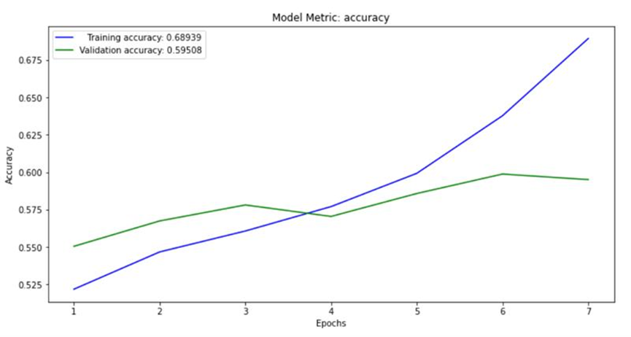
Building the Models
The model could probably be trained a little more as the trend for accuracy at least for the training dataset is still rising for the last few epochs.
Generally, when the training data accuracy keeps improving while the validation data accuracy is getting worse, we are encountering overfitting.
1. Model - Convolutional neural network
Model metric: Accuracy
Accuracy is a statistical measure which shows the proportion of correct predictions of a model
Data Augmentation Results

Slide 18

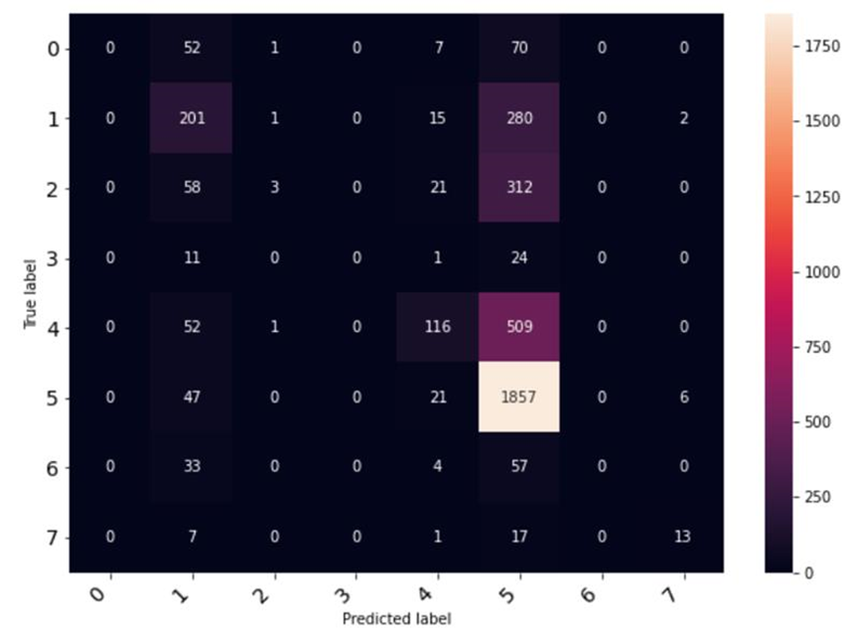
Building the Models
1. Model - Convolutional neural network
At this point we use the test dataset in order to figure the performance of the model in terms of prediction
Class | Precision | Recall | f1-score | support
0 | 0,00 | 0,00 | 0,00 | 130
1 | 0,44 | 0,40 | 0,42 | 499
2 | 0,50 | 0,01 | 0,02 | 394
3 | 0,00 | 0,00 | 0,00 | 36
4 | 0,62 | 0,17 | 0,27 | 678
5 | 0,59 | 0,96 | 0,73 | 1.931
6 | 0,00 | 0,00 | 0,00 | 94
7 | 0,62 | 0,34 | 0,44 | 38
Accuracy |  |  | 0,58 | 3.800
macro avg | 0,35 | 0,24 | 0,23 | 3.800
weighted avg | 0,53 | 0,58 | 0,48 | 3.800
The numbers show that:
on weighted average 53% of total predictions for each of the classes were actually of the predicted class
For classes that there was not enough information the results are obviously not good.
Specifically, in our model 58% of the total predictions were right.
The results of our model based on the confusion matrix do not offer much more information in comparison to the classification report. However, it is clear that some specific categories are classified correctly (the ones prevailing in the dataset), while the rest have been mainly misclassified
Data Augmentation Results

Slide 19

Building the Models
2. Model - Convolutional neural network (augmented data)
It seems that the CNN model misperformed due to overfitting.
This is exactly the reason why we performed data augmentation techniques at an early stage. Let us now see to what extent this will fix this issue.
To be noted that the model was built similarly to the previous model.
Data Augmentation Results

Slide 20
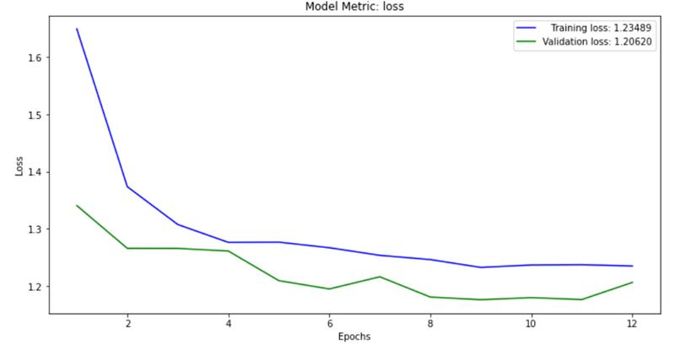
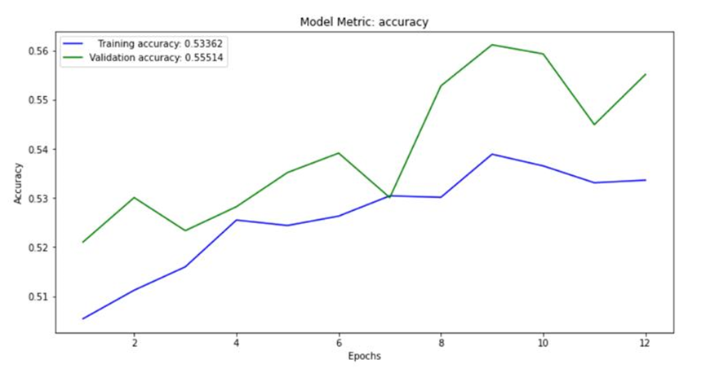
Building the Models
2. Model – CNN (augmented data)
The loss function decreases rapidly in the first four epochs, and from that point and on the curve starts to flatten in terms of training.
As expected, the results are significantly better to those derived from the previous model as the validation loss ends up approaching the training loss value.
In terms of accuracy, the results are also satisfactory as both metrics are increasing through epochs. However, we observe better accuracy values for validation than for training dataset.
This may be attributed to the fact that there might be difficult examples in the training dataset, but only simple examples in the validation datasets.
Data Augmentation Results

Slide 21
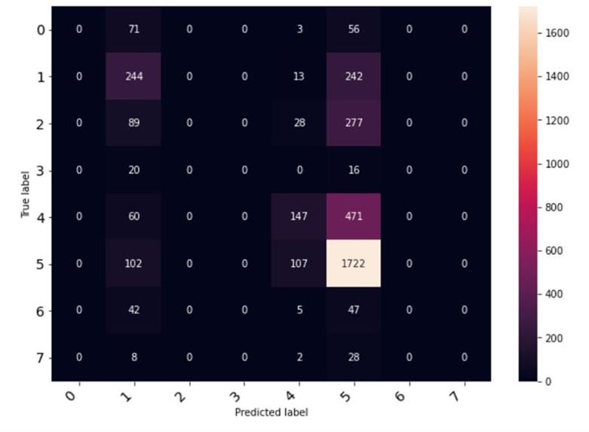
Building the Models
2. Model – CNN (augmented data)
Let us figure the performance of the model in terms of prediction
Class | Precision | Recall | f1-score | support
0 | 0,00 | 0,00 | 0,00 | 130
1 | 0,38 | 0,49 | 0,43 | 499
2 | 0,00 | 0,00 | 0,00 | 394
3 | 0,00 | 0,00 | 0,00 | 36
4 | 0,48 | 0,22 | 0,30 | 678
5 | 0,60 | 0,89 | 0,72 | 1.931
6 | 0,00 | 0,00 | 0,00 | 94
7 | 0,00 | 0,00 | 0,00 | 38
Accuracy |  |  | 0,56 | 3.800
macro avg | 0,18 | 0,20 | 0,18 | 3.800
weighted avg | 0,44 | 0,56 | 0,48 | 3.800
For classes that we did not have many image samples, the results are even worse than those of the previous mode. The accuracy metric, though, has remained at the same level
Based on the weighted average, 44% of predictions for each of the classes were actually of the predicted class, taking again into consideration the proportion of each class in the dataset.
Data Augmentation Results

Slide 22

Building the Models
3. Pre-trained Model – VGG16 (augmented data)
VGG16 is a convolution neural net (CNN ) architecture which was used to win ILSVR (Imagenet) competition in 2014 and up until now it is considered as one of the best practices in terms of deep learning .
Why we chose it?
It gives us the chance to use a model which has been trained on millions of images, which would take days or even weeks for a custom-made convolutional neural network
There is no need for a vast training dataset as the model can already detect easily patterns.
It brings better accuracy results
Data Augmentation Results

Slide 23
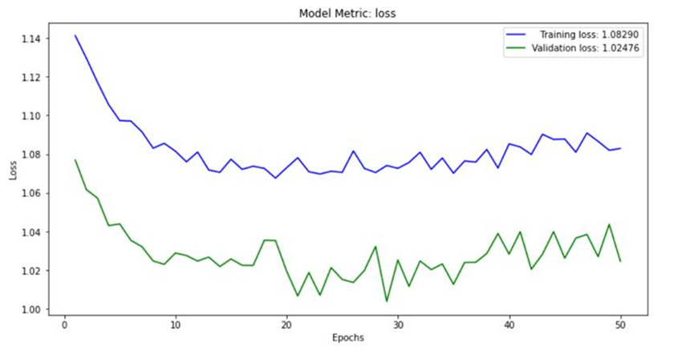
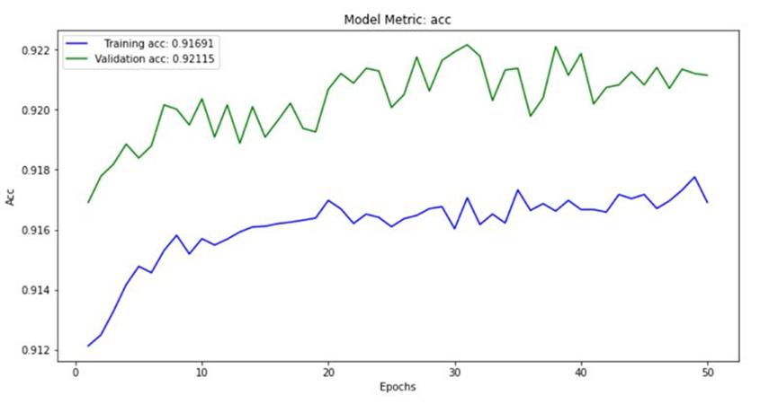
Building the Models
3. Pre-trained model VGG16
For the pre-trained model the loss function for both validation and training dataset decreases significantly for the first 10 epochs.
After that point the two curves start to stabilize and take values upside-down between a range of numbers. Either way, the results are promising as loss is optimized for both datasets in comparison to the other models.
For both validation and test dataset the accuracy performance exceeds 90%, meaning that the network was learning fast.
Moreover, the curve starts to flatten at the final steps indicating that not too many epochs are required to train the model further
Data Augmentation Results

Slide 24
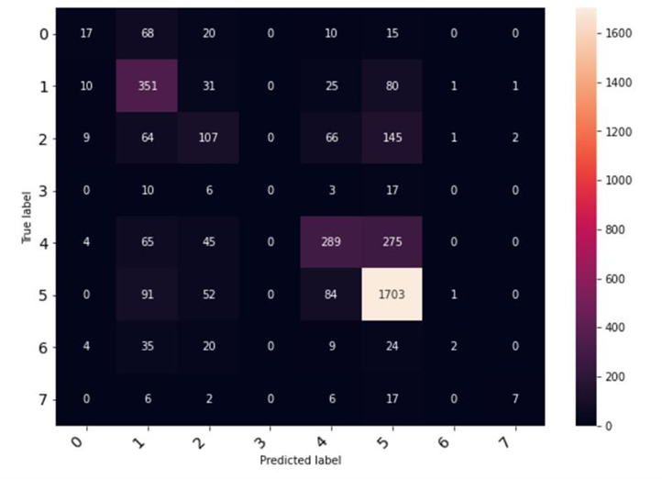
Building the Models
3. Pre-trained model VGG16
Let us figure the performance of the pre-trained model in terms of prediction
Class | Precision | Recall | f1-score | support
0 | 0,39 | 0,13 | 0,20 | 130
1 | 0,51 | 0,70 | 0,59 | 499
2 | 0,38 | 0,27 | 0,32 | 394
3 | 0,00 | 0,00 | 0,00 | 36
4 | 0,59 | 0,43 | 0,49 | 678
5 | 0,75 | 0,88 | 0,81 | 1.931
6 | 0,40 | 0,02 | 0,04 | 94
7 | 0,70 | 0,18 | 0,29 | 38
Accuracy |  |  | 0,65 | 3.800
macro avg | 0,46 | 0,33 | 0,34 | 3.800
weighted avg | 0,62 | 0,65 | 0,62 | 3.800
Based on the weighted average, 62% of predictions for each of the classes were actually of the predicted class
Contrary to all other models, where the precision metric for classes with short volume was equal to zero, in the pre-trained model this is encountered once.
The accuracy metric 65% is the best seen so far.
We can also confirm that the model has achieved better predictions only by looking at the diagonal of the confusion Matrix, as in the other models we depicted more zero cases
Data Augmentation Results

Slide 25

Conclusions

Slide 26

Conclusions
The learning methods developed by Machine Learning procedures offer tremendous potential to enhance medical research and clinical care The main idea is that systems can learn from data, identify patterns and make decisions with minimal human intervention and that is what we attempt to do in this report.
We constructed a CNN model from the initial dataset, a CNN model based on augmentation techniques and a pretrained VGG16 model. The first model was overfitted and we overcome this issue with the second model that brought more slightly different images to train. However, the performance of both models was not desirable. That is why we proceeded with a third model.
By taking into consideration classification metrics, such as accuracy, loss and precision measurement in order to evaluate the models, we concluded that the pretrained model had the best performance.
However, and in any case the model could be better if the data were balanced and not mostly distributed to specific types of class.
Data Augmentation Results

Slide 27
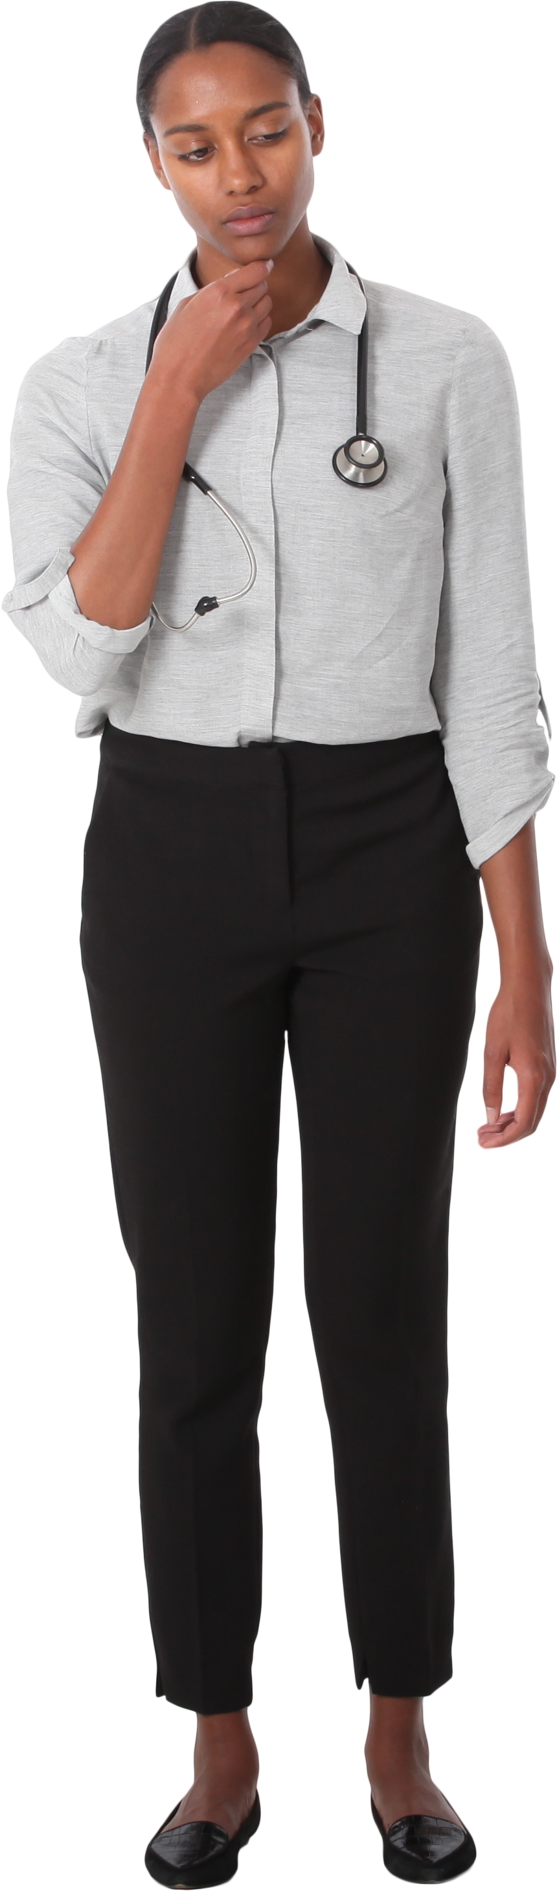

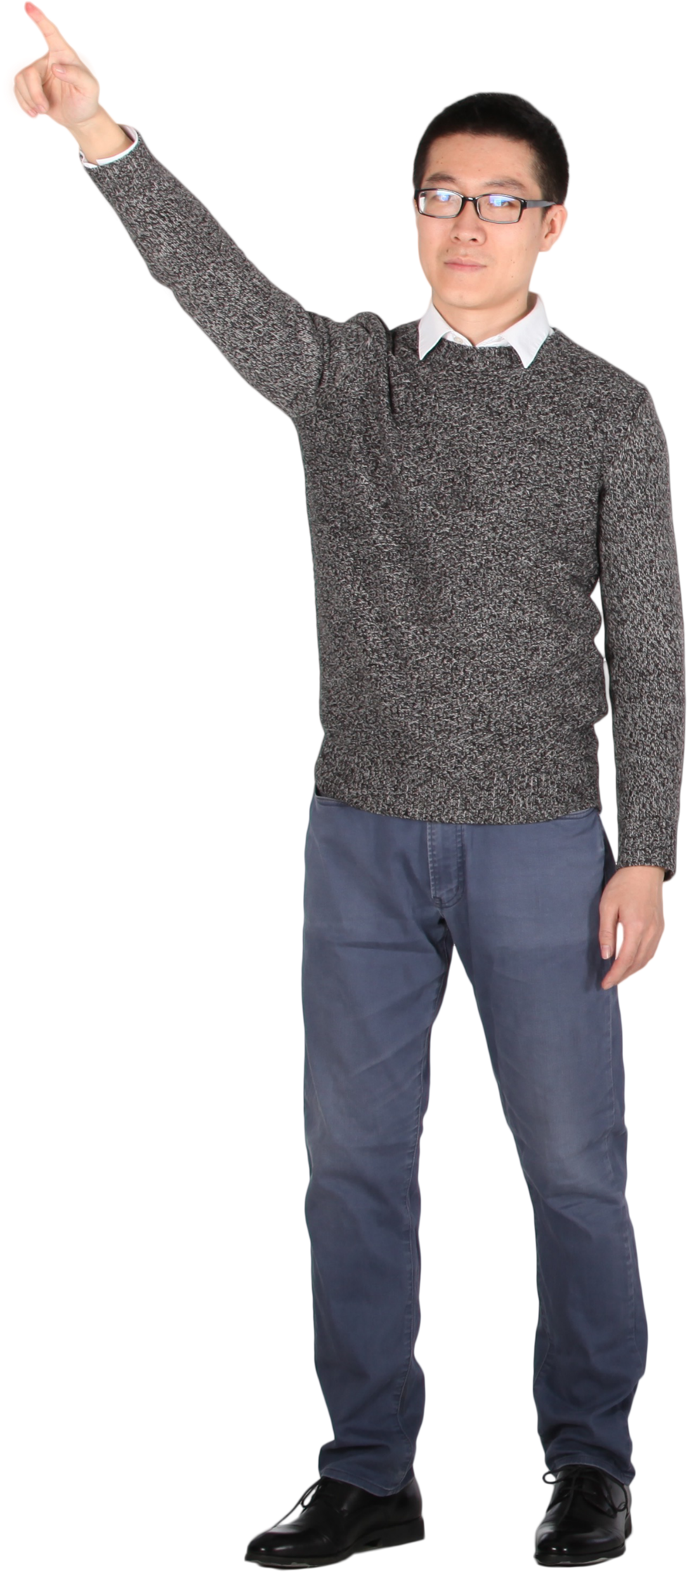
Thank you for your attention!
Questions

